Slide 1

Task 25
Analysis Sales Data
Name: Basel Amr Barakat
Email: baselamr52@gmail.com

Slide 2
Introduction
Objective : Develop a comprehensive bookstore database to manage authors, books, and sales.
Scope : Design tables for Authors, Books, and Sales; insert sample data; perform SQL queries.

Slide 3
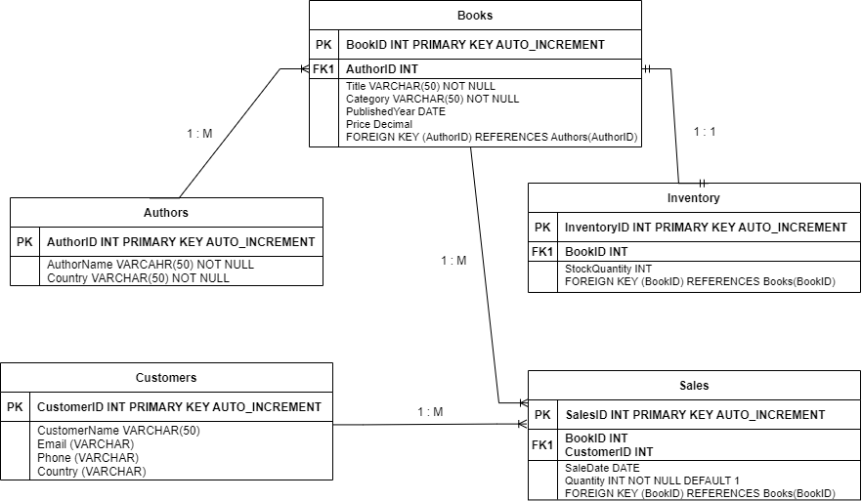
Database Design

Slide 4
Requirement One
Create Database and Tables

Slide 5
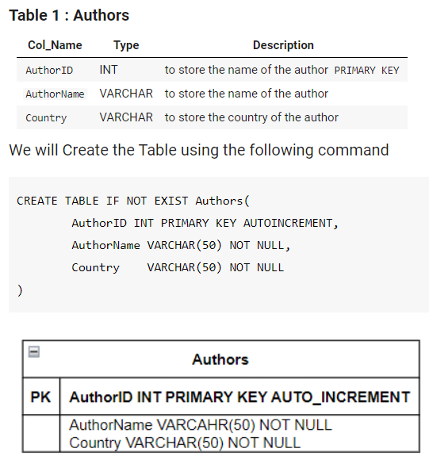
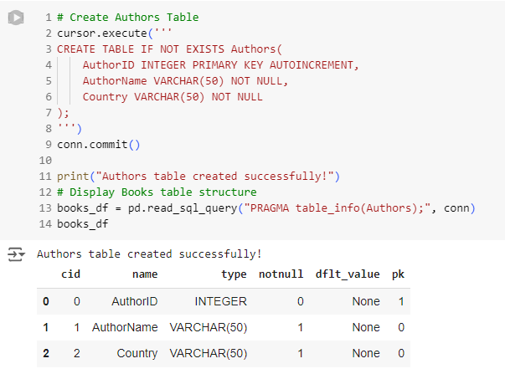
1.1 Create Author Table

Slide 6
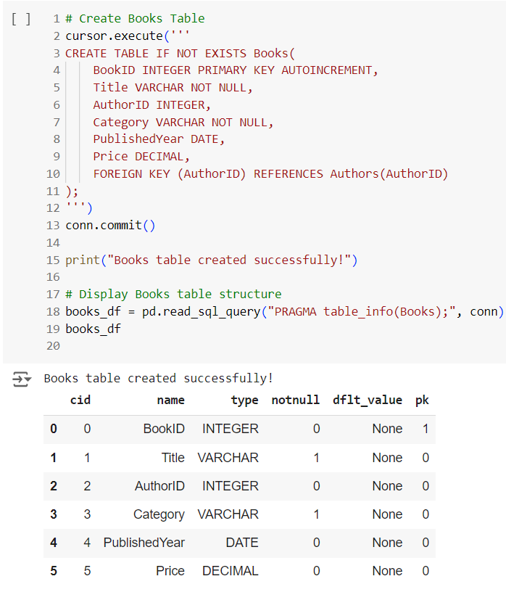
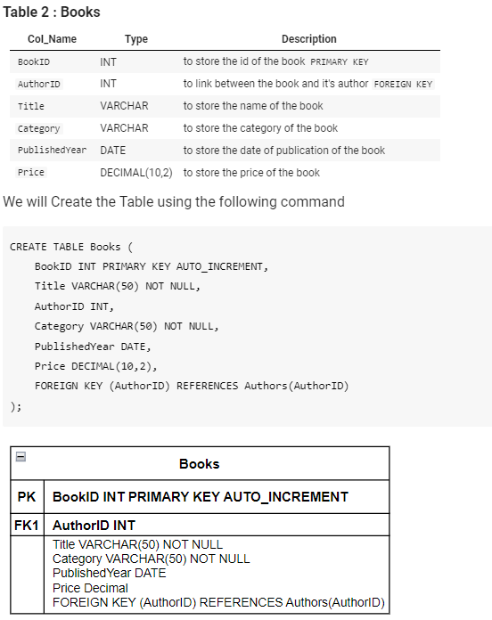
1.2 Create Books Table

Slide 7
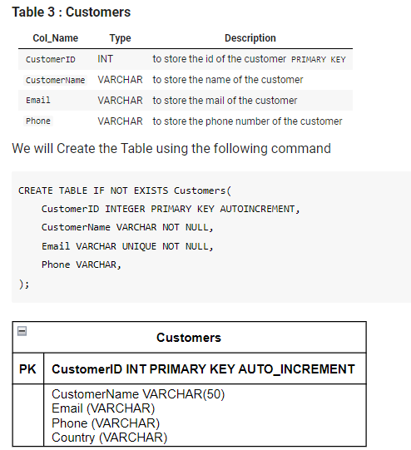
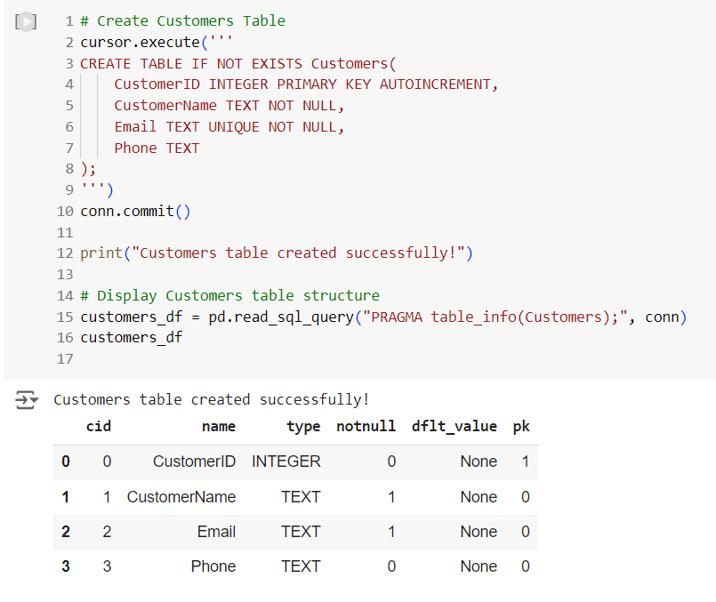
1.3 Create Customers Table

Slide 8
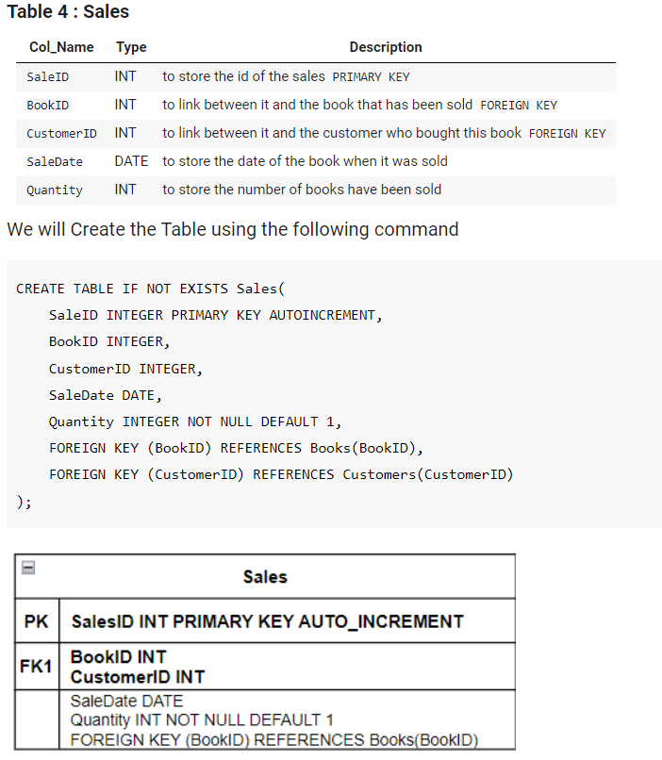
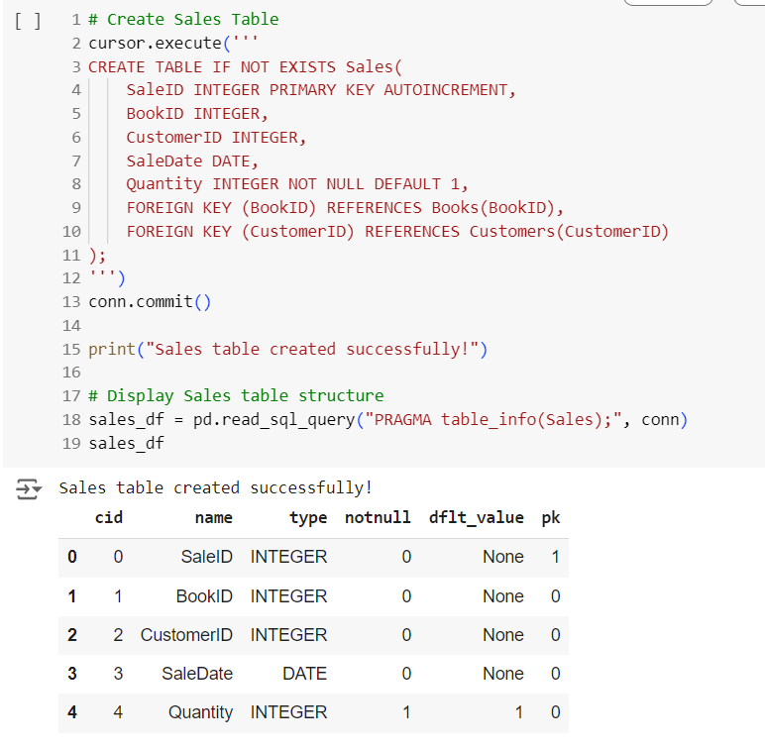
1.4 Create Sales Table

Slide 9
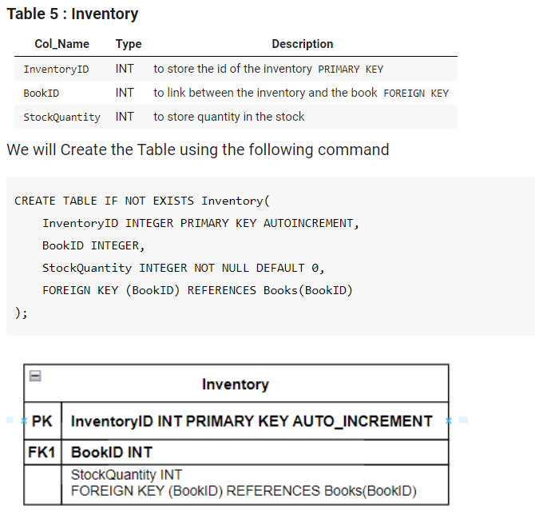
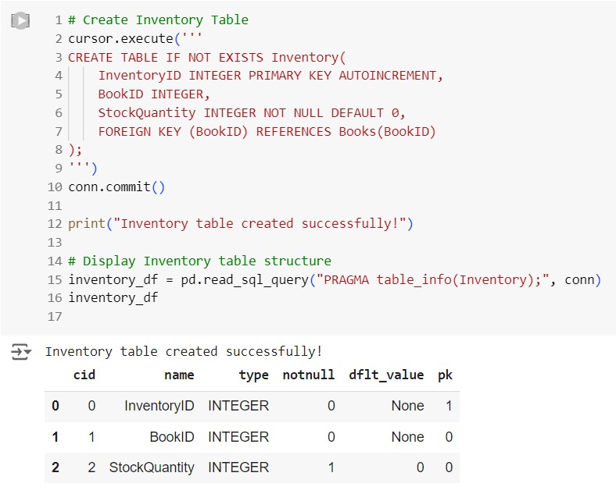
1.5 Create Inventory Table

Slide 10
Requirement Two
Insert Sample Data

Slide 11
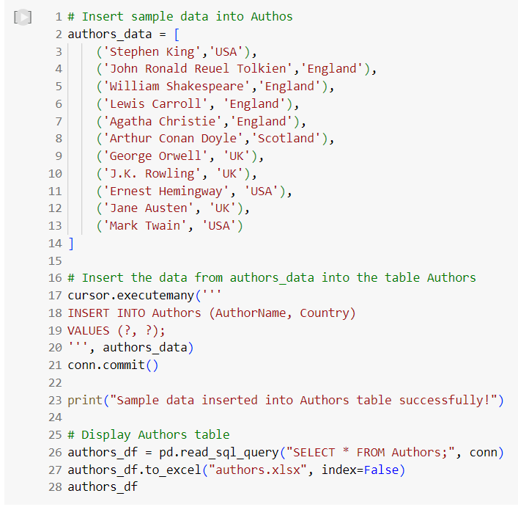
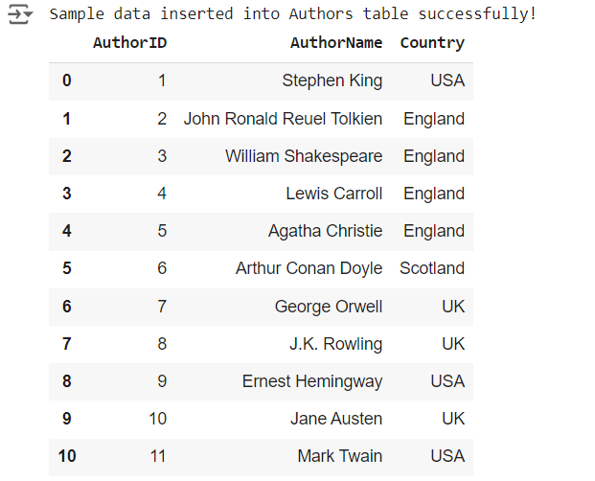
2.1 Insert Data on Author Table

Slide 12
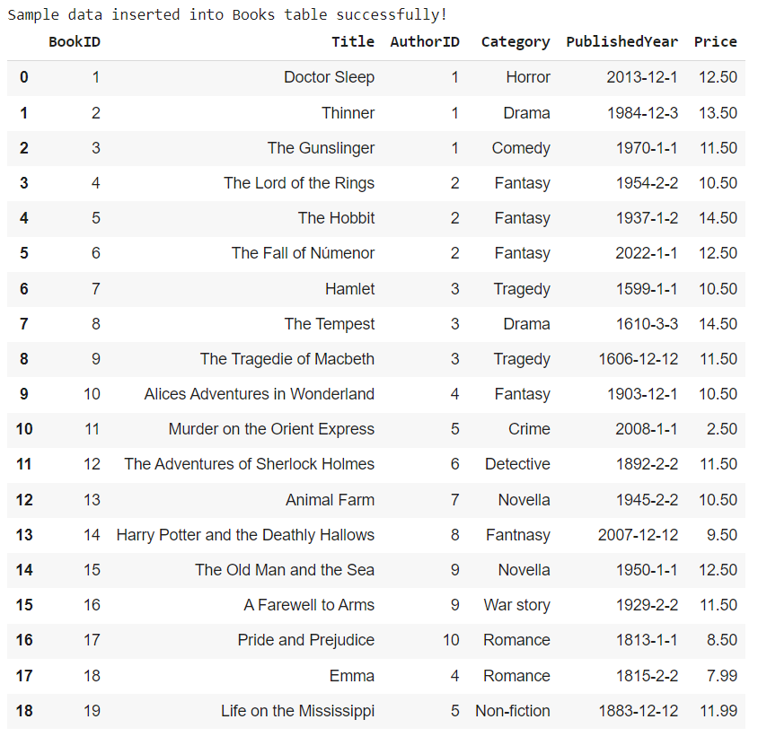
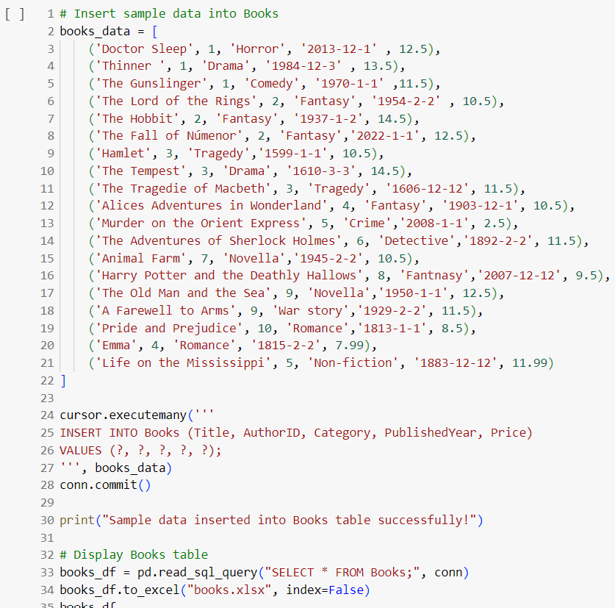
2.2 Insert Data on Books Table

Slide 13
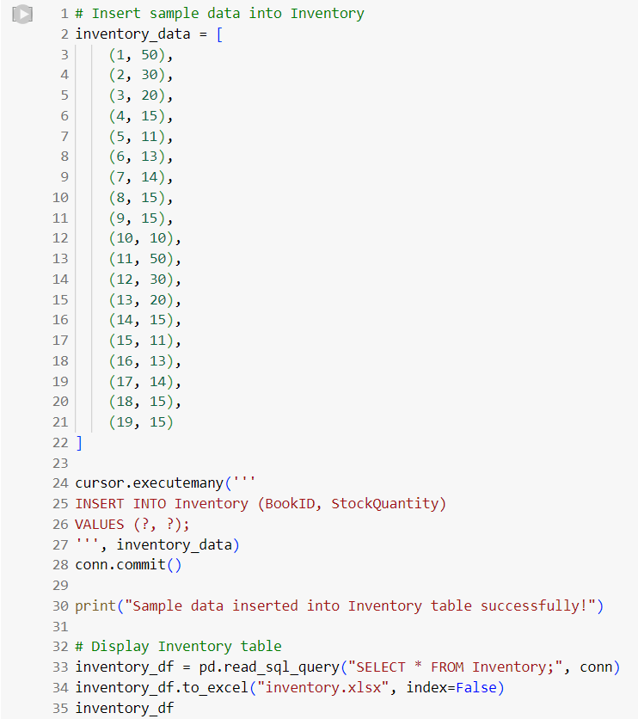
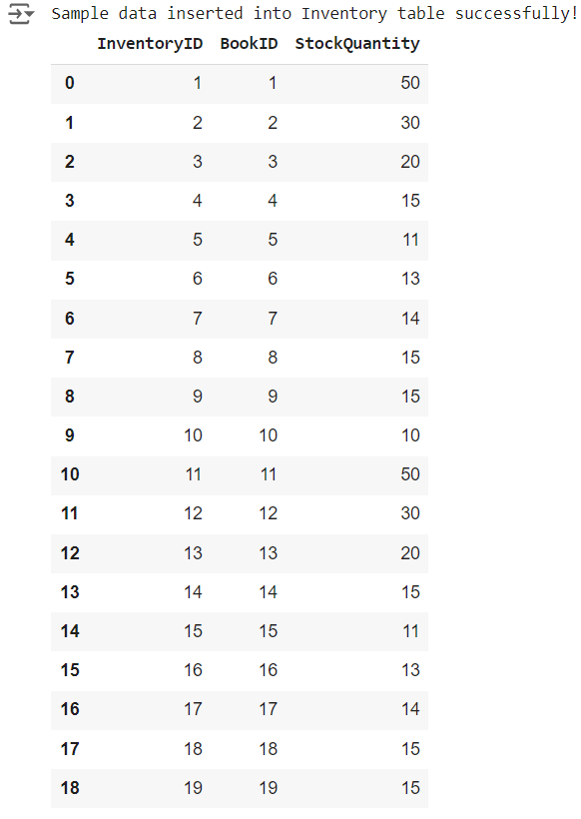
2.3 Insert Data on Inventory Table

Slide 14
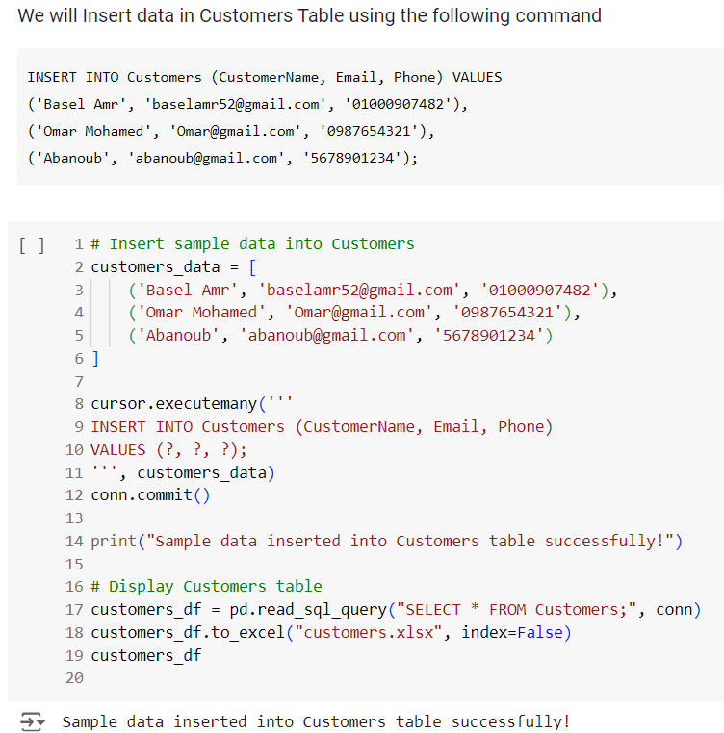
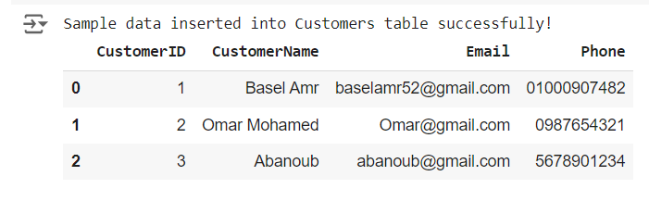
2.4 Insert Data on Sales Table

Slide 15
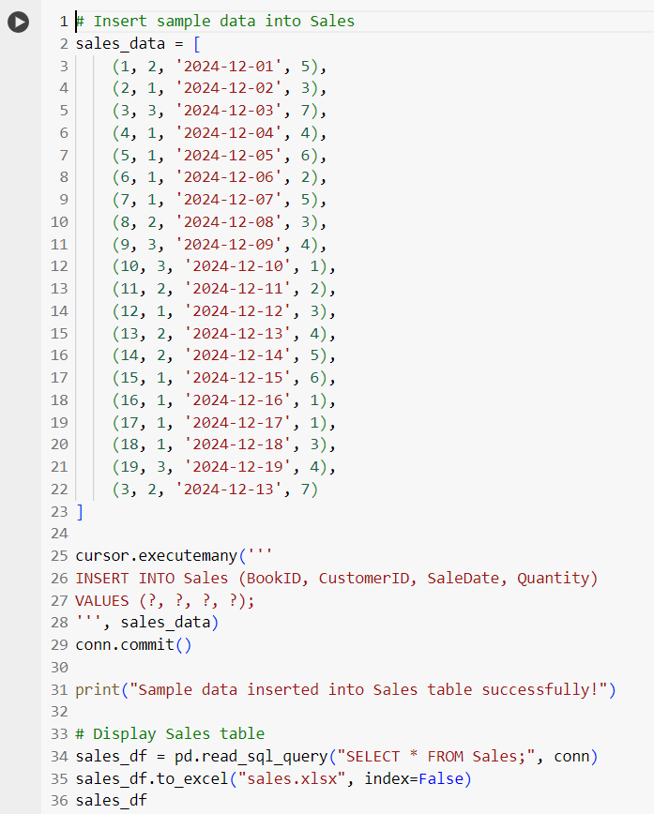
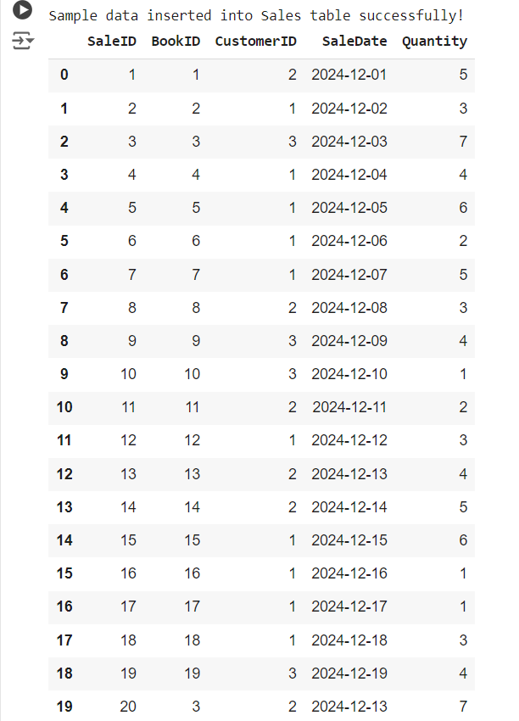
2.5 Insert Data on Inventory Table

Slide 16
Requirement Three
Query and Use SQL Joins

Slide 17
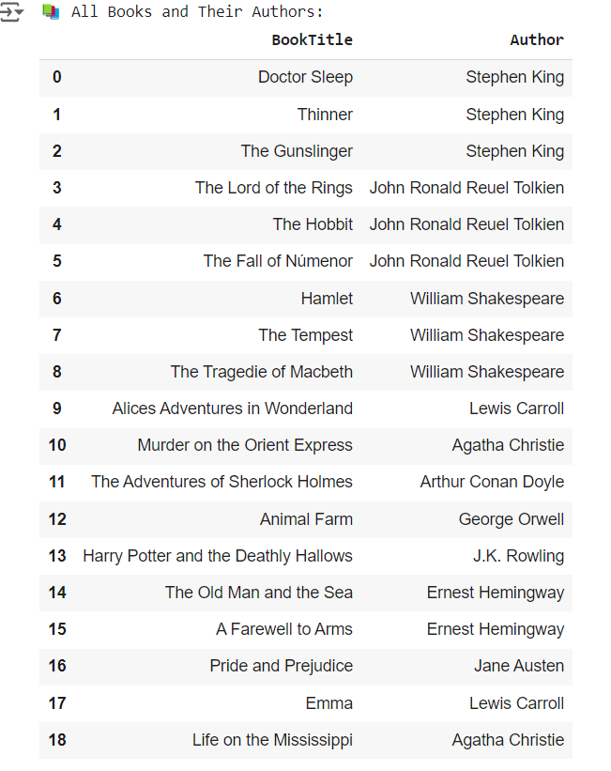
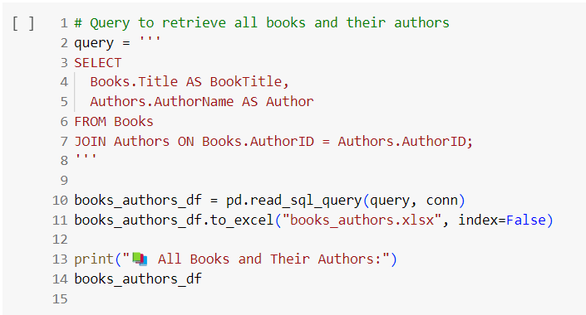
3.1 Write queries to retrieve all books and their authors

Slide 18
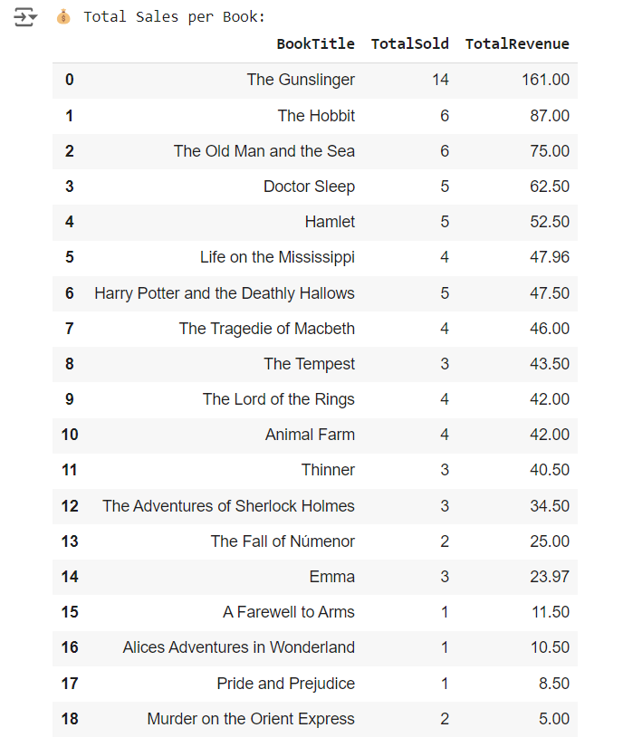
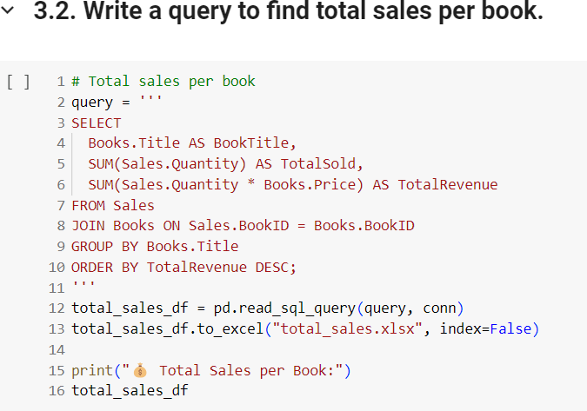
3.2 Write a query to find total sales per book

Slide 19
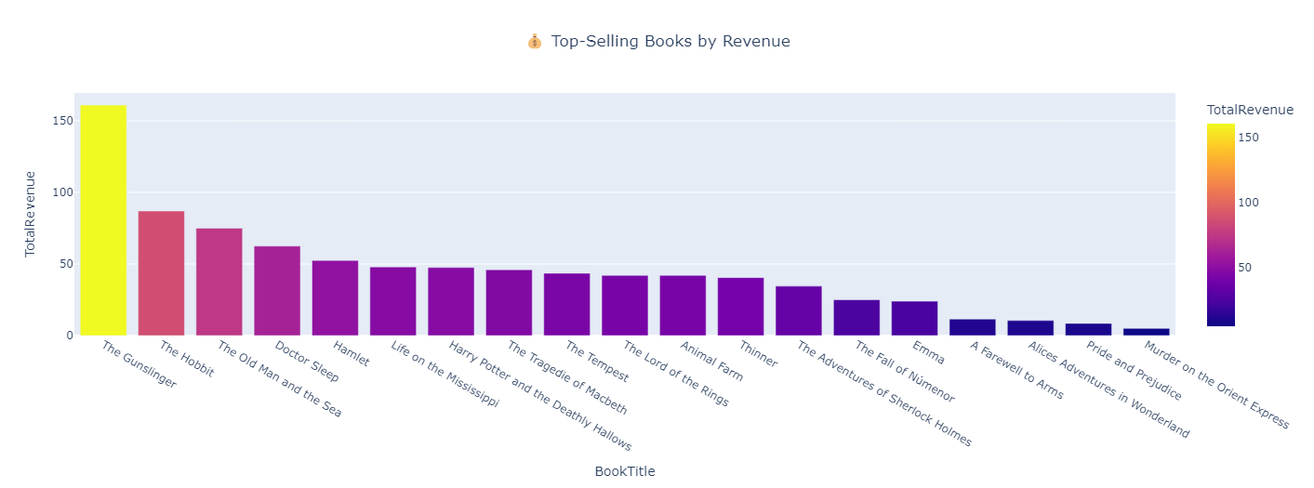
3.2 Visualization

Slide 20
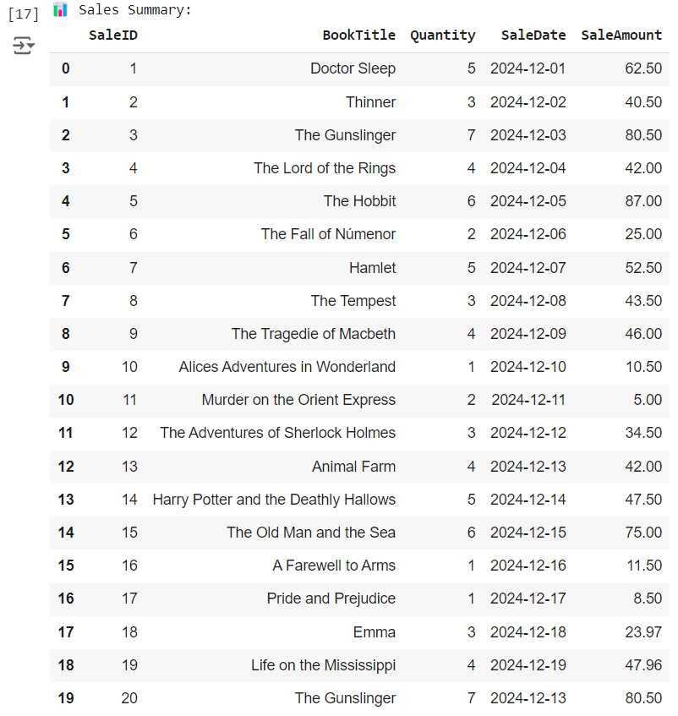
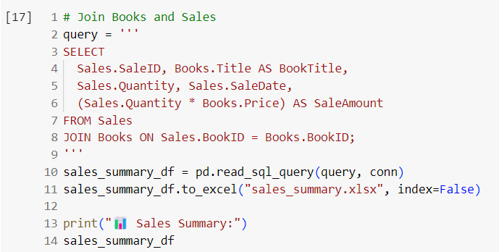
3.3 Write a query using join to combine data from books and Sales

Slide 21
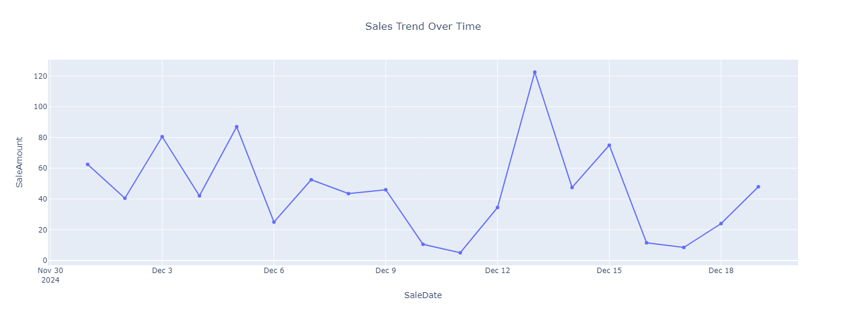
3.3 Visualization

Slide 22
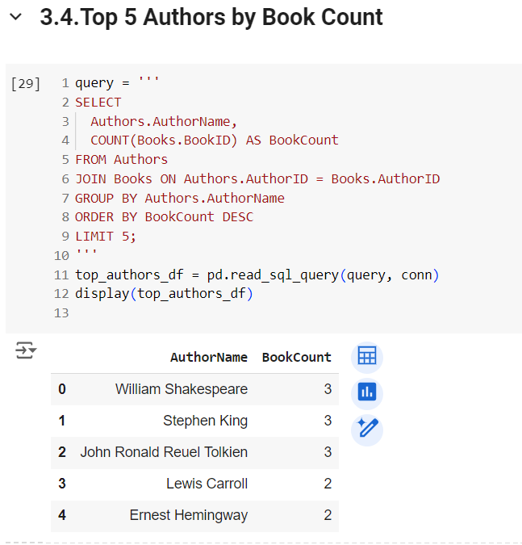
3.4 Top 5 Authors by books

Slide 23
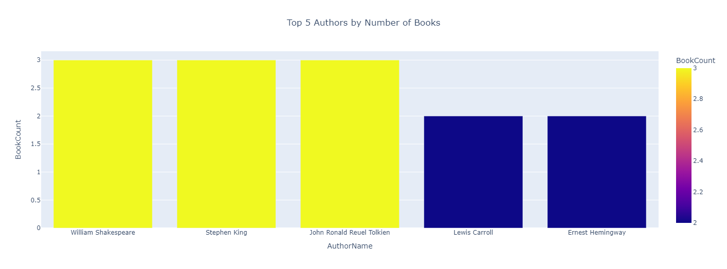
3.5 Visualization

Slide 24
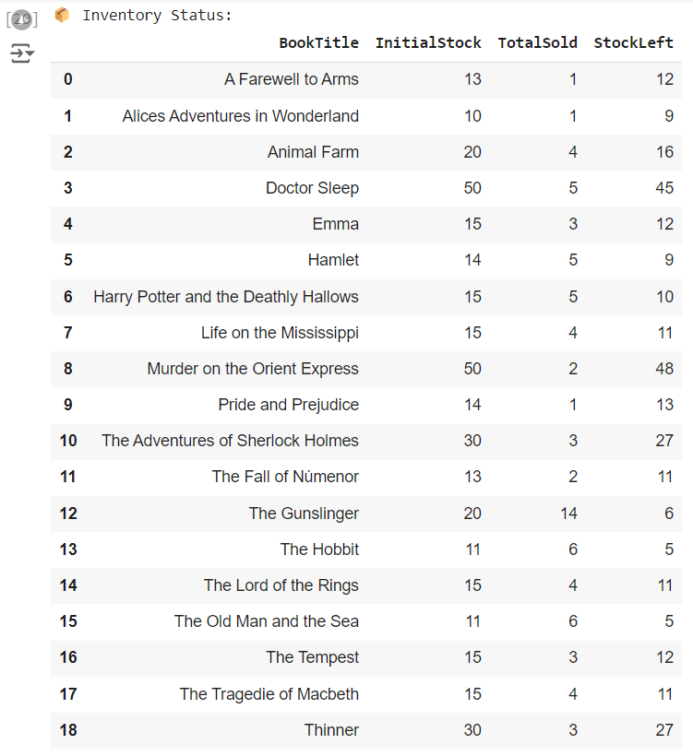
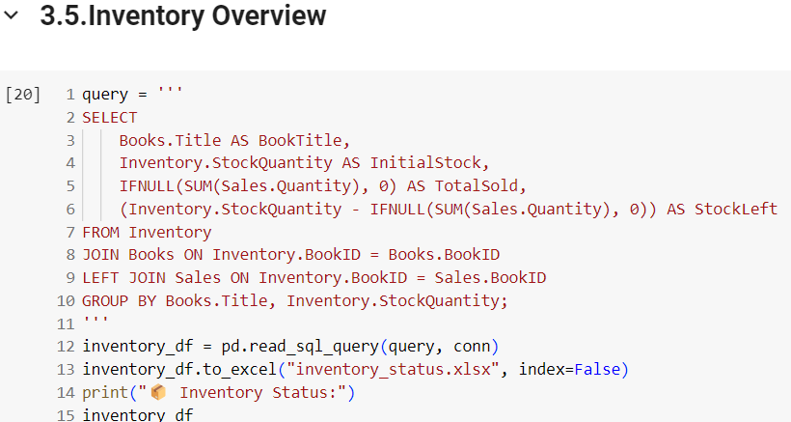
3.5 Inventory Overview

Slide 25
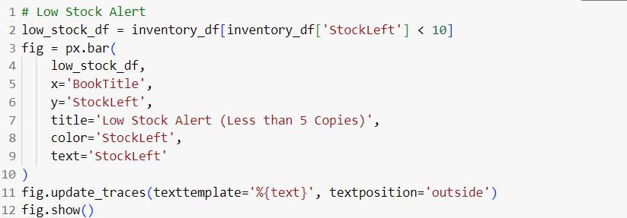
3.5 Low Stock Alert

Slide 26
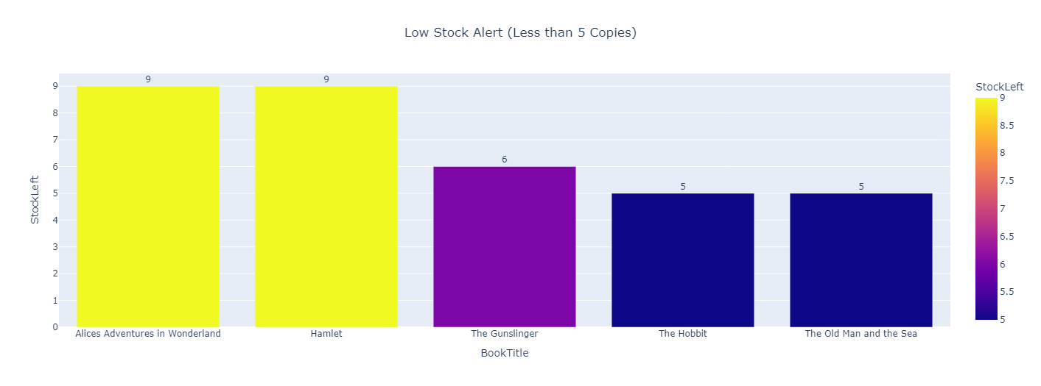
3.5 Visualization

Slide 27
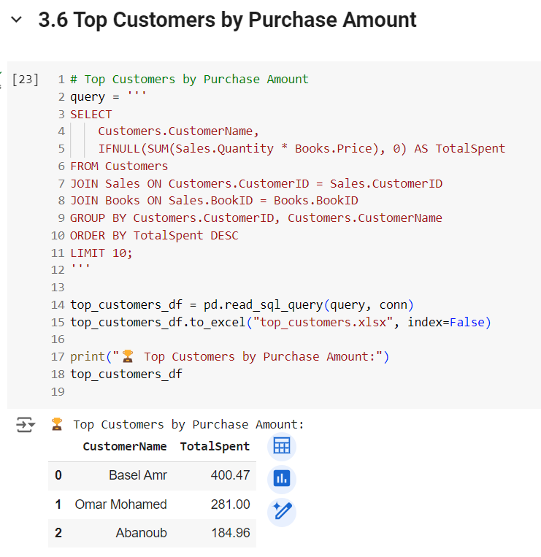
3.6 Top 5 Customers by Purchase Amount

Slide 28
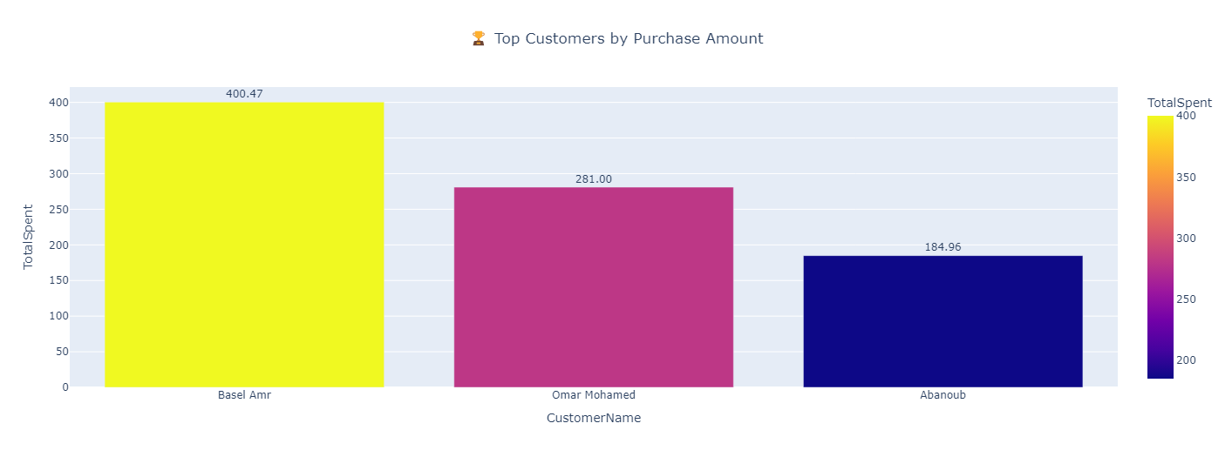
3.6 Visualization

Slide 29
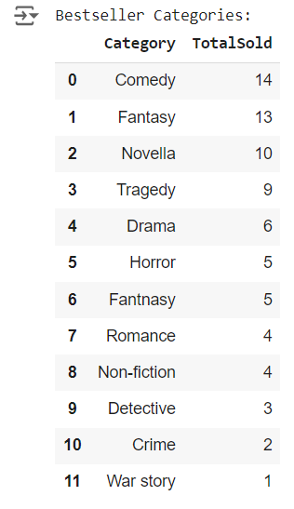
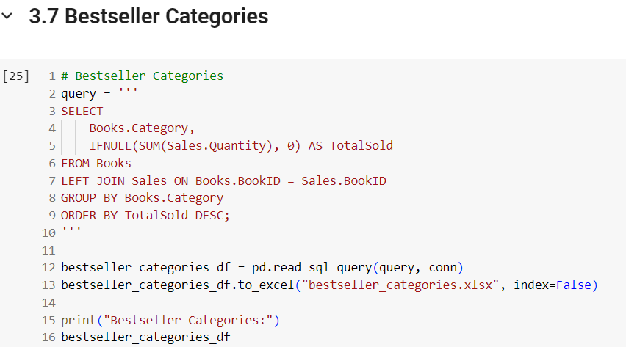
3.7 Bestsellers based on categories

Slide 30

3.7 Visualization

